Slide 1
Contents
Introduction
Digital Audio
Audio Compression
Streaming Stored Media (Audio)
Streaming Live Media – Internet Radio
Real Time Conferencing – Voice over IP

Slide 2
Introduction
What is Multimedia
The Idea began in 1970’s but it is only in 2000’s that the real time audio and video traffic has grown.
Two things happened to enable this growth
Advanced Computers that are capable of processing audio and video data easily
A flood of bandwidth have become available
These developments allow ISPs to carry tremendous levels of traffic across their backbones and mean that ordinary users can connect to the Internet 100–1000 times faster than with a 56-kbps telephone modem.

Slide 3
Digital Audio
An audio (sound) wave is a one-dimensional acoustic (pressure) wave
When an acoustic wave strikes a microphone, the microphone generates an electrical signal, representing the sound amplitude as a function of time.
Digital audio is a digital representation of an audio wave that can be used to recreate it.
Jitter of only a few milliseconds during the play out of multimedia affects the perceived sound quality much more than it affects the perceived image quality.
An ADC takes an electrical voltage as input and generates a binary number as output.

Slide 4
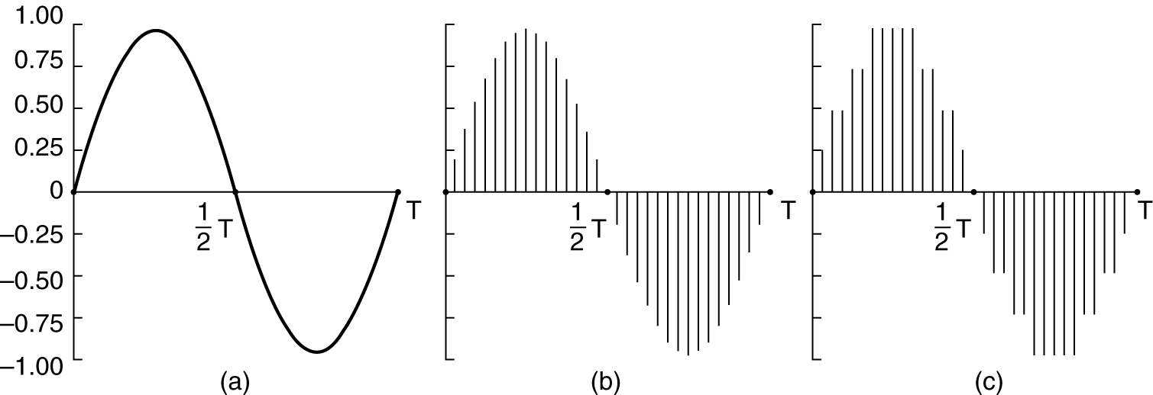
Digital Audio
(a) A sine wave. (b) Sampling the sine wave. (c) Quantizing the samples to 4 bits.

Slide 5
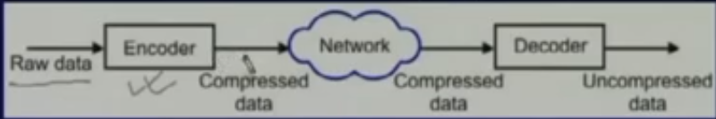
Audio Compression
Compression Converts an input data stream to another data stream of smaller size.
Why Compression:
Reduced Storage space
Reduces Bandwidth
Lower Communication Cost
New Applications.
Types:
Lossy
Lossless

Slide 6
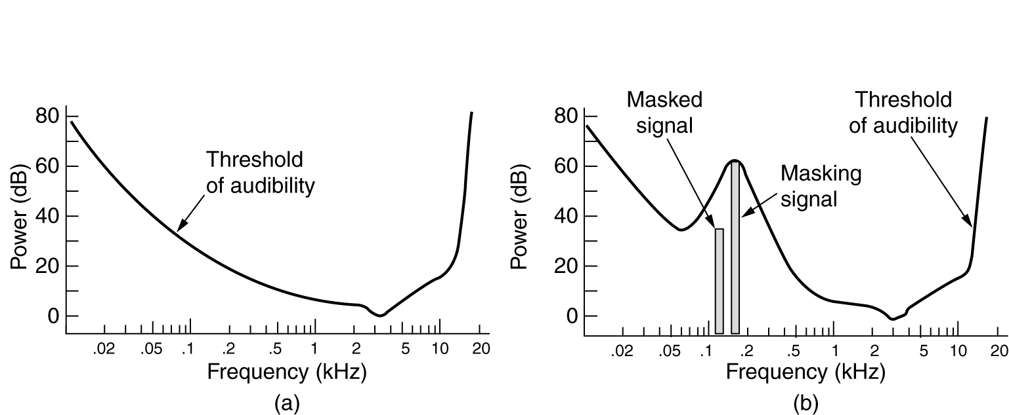
Audio Compression
It can be done in two ways
Waveform Coding.
The signal is transformed mathematically by a Fourier transform into its frequency components
Perceptual Coding.
It is based on psychoacoustics—how people perceive sound.

Slide 7
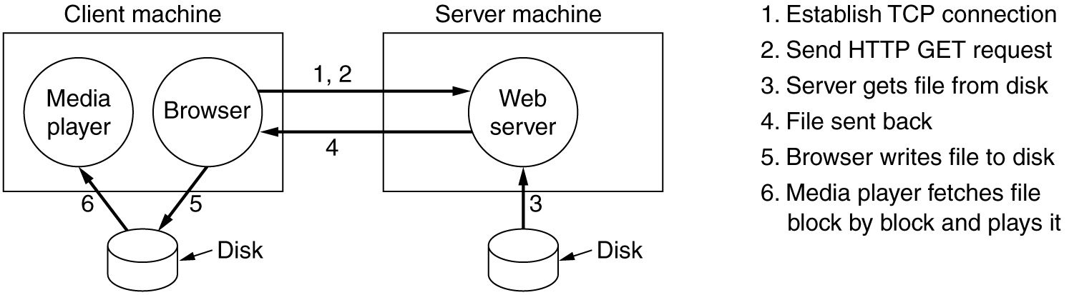
Streaming Stored Audio

Slide 8
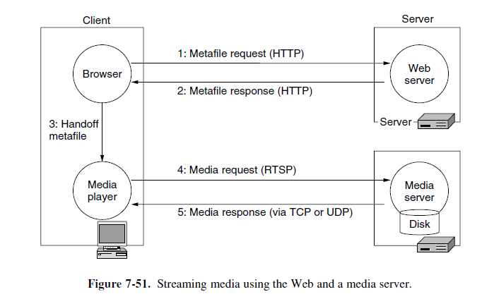
Streaming Stored Audio

Slide 9
Streaming Stored Audio
The media server uses RTSP (Real Time Streaming Protocol)
The media player has four major jobs to do:
Manage the user interface.
Handle transmission errors.
Decompress the content.
Eliminate jitter.
Most media players nowadays have a glitzy user interface. Often there are interchangeable front panels, called skins, that the user can drop onto the player. The media player has to manage all this and interact with the user.

Slide 10
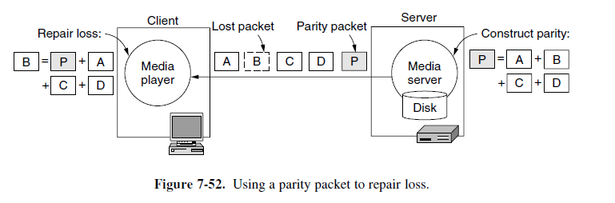
Streaming Stored Audio
Handling Transmission Errors:
Forward Error Correction (FEC).
For every four data packets that are sent, a fifth parity packet can be constructed and sent. It is shown in the following diagram

Slide 11
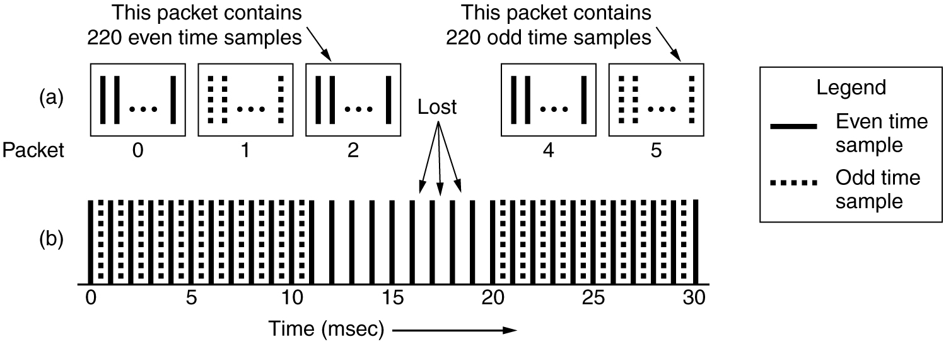
Streaming Stored Audio
Handling Transmission Errors:
Interleaving
This approach is based on mixing up or interleaving the order of the media before transmission and un mixing or de-interleaving it on reception.
It will not result in a single, large gap when the media is played out.

Slide 12
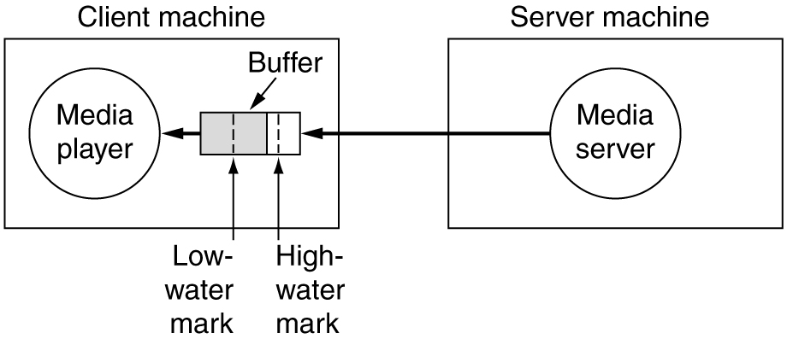
Streaming Stored Media
Decompressing the content:
The encoding process must be designed to permit decoding despite packet loss.
Due to this MPEG uses I-, P- and B-frames. Each I-frame can be decoded independently of the other frames to recover from the loss of any earlier frames.
Eliminating jitter
The general Solution for this is
to use a playout buffer.

Slide 13
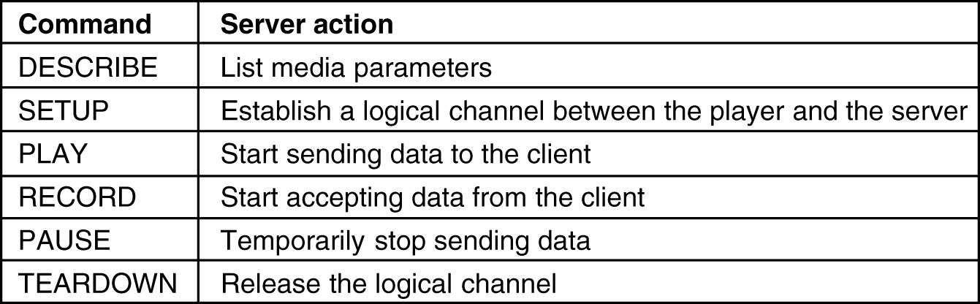
Streaming Stored Media
To start and stop the flow of media, the media player needs a remote control for it. This is what RTSP provides. The main commands provided by RTSP are as follows:

Slide 14
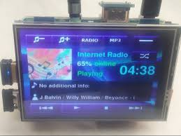
Streaming Live Audio
Not only recorded videos that are tremendously popular on the Web. Live media streaming is very popular too.
Once it became possible to stream audio and video over the Internet, commercial radio and TV stations got the idea of broadcasting their content over the Internet as well as over the air.
The IP Television and Internet Radio are the Result
of it

Slide 15
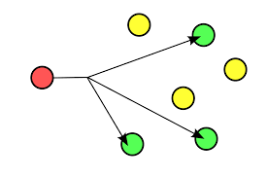
Stored Streaming vs Live Streaming
A larger amount of buffering is often needed for live streaming
Live streaming events usually have hundreds or thousands of simultaneous viewers of the same content
Under these circumstances, the natural solution for live streaming is to use multicasting.

Slide 16
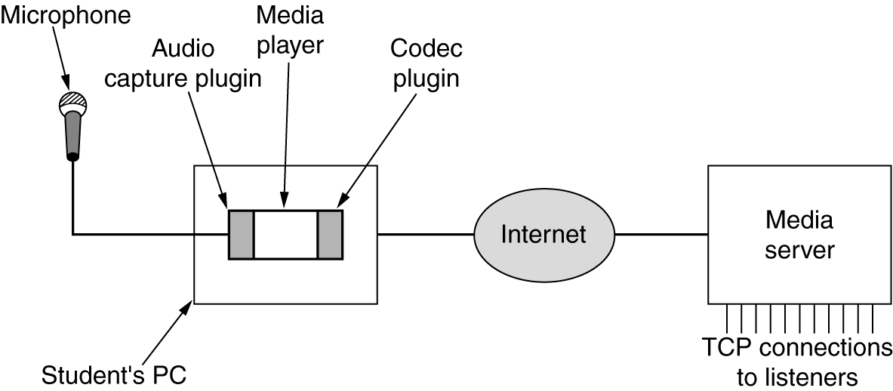
Internet Radio
Setting up and operating a streaming media server such as an Internet radio station is so easy such that a student can make it.
The Main components are illustrated in the following Fig.

Slide 17
Real time Conferencing- Voice over IP
Voice traffic is now carried using Internet technologies, and represents only a tiny fraction of the network bandwidth
This disruptive technology is known as voice over IP, and also as Internet telephony.
One approach to achieve this is to plug the telephone networks into the Ethernet and send calls over the network.
Pehr Anderson an undergraduate student at M.I.T……………
Another approach is to use IP technology to build a long-distance telephone network.

Slide 18
Major Issues
Latency:
Achieving low latency in Real time conferencing is very difficult task.
We can achieve it by using UDP instead of TCP
Another approach is to reduce packet size
Setup and Tear down of calls:
There are two major protocols that deal with this issue. They are
H.323
SIP (Session Initiation Protocol)

Slide 19
H.323
In 1996, ITU issued recommendation H.323, entitled ‘‘Visual Telephone Systems and Equipment for Local Area Networks Which Provide a Non-Guaranteed Quality of Service.’’
It was quickly changed to ‘‘Packet-based Multimedia Communications Systems’’ in the 1998 revision.
The main components of this H.323 protocol were:
Gateway
Terminals
Gatekeeper
Zone

Slide 20
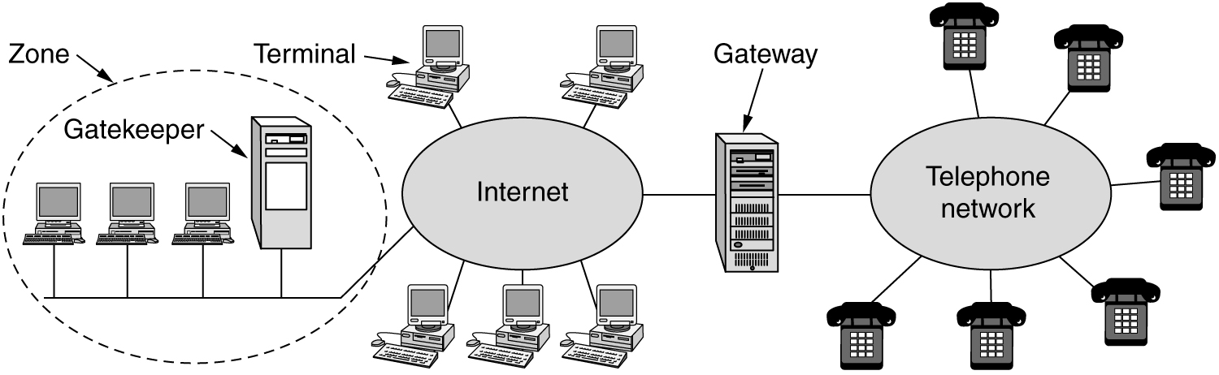
H.323
The Gateway speaks the H.323 protocols on the Internet side and the PSTN protocols on the telephone side

Slide 21
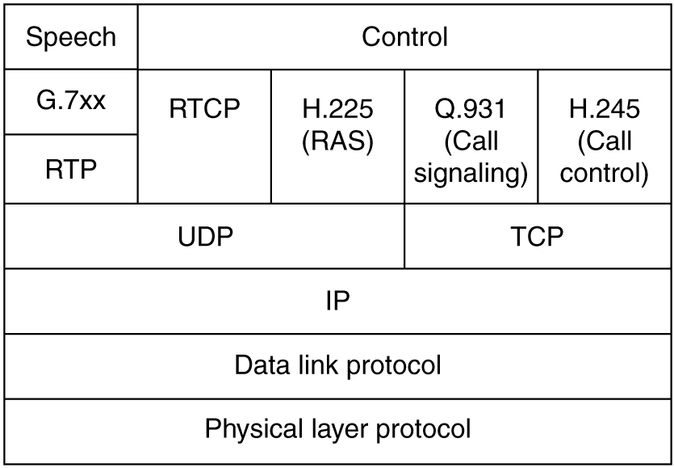
H.323
Speech- Audio/Video
H.225-protocol for talking to
Gatekeeper
H.245- to Negotiate about
compression technique to be used
Q.931- It is establishing, releasing
connections, making ringing sounds etc
RTP- Real time transport Protocol to transfer data
RTCP-Real time Transfer Control Protocol,
UDP,TCP,IP- Transmission protocols.

Slide 22
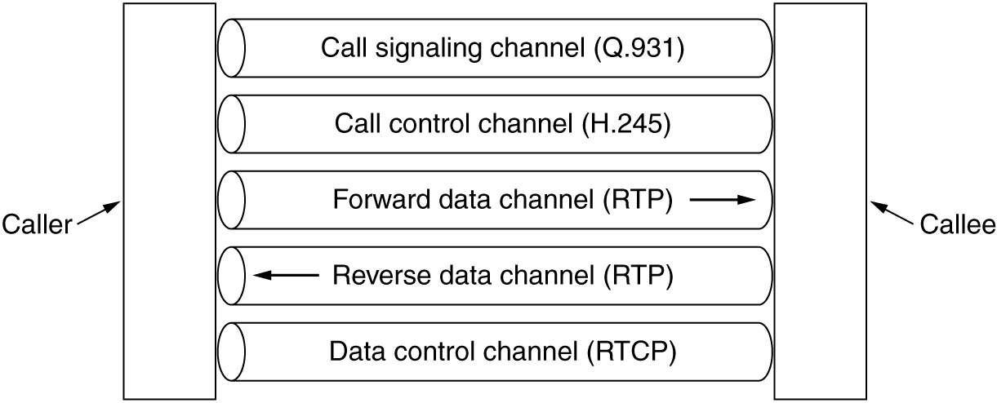
H.323
Logical channels between the caller and callee during a call.

Slide 23
SIP(Session Initiation Protocol)
IETF set up a committee to design a simpler and more modular way to do voice over IP.
The major result to date is SIP (Session Initiation Protocol).
This protocol describes how to set up Internet telephone calls, video conferences, and other multimedia connections.
Unlike H.323, which is a complete protocol suite, SIP is a single module, but it has been designed to interwork well with existing Internet applications.
SIP can establish two-party sessions
Multiparty sessions (where everyone can hear and speak),
multicast sessions (one sender, many receivers).

Slide 24
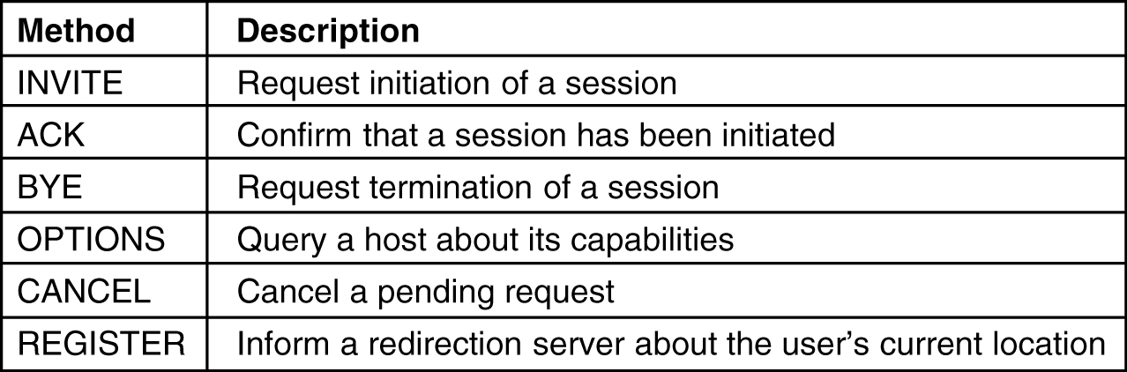
SIP methods
The SIP methods defined in the core specification.

Slide 25
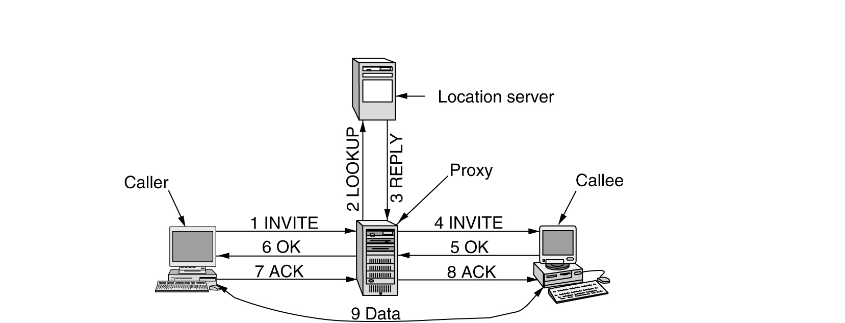
SIP
Use a proxy and redirection servers with SIP.

Slide 26
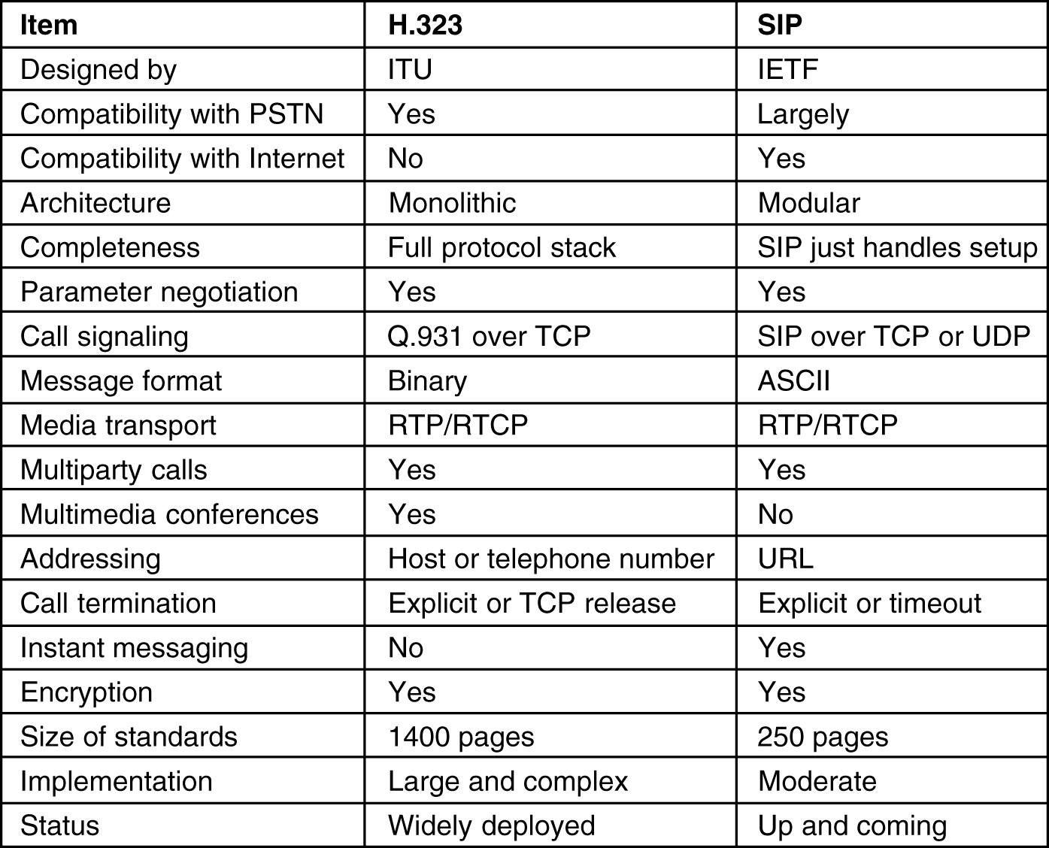
Comparison of H.323 and SIP

Slide 27
Thank You
- A.Vijay

